Slide 1
Home Automation
Using Arduino and Wifi
Presentation by
Sameer Dudeja (160102172)
Akul Agarwal (160102175)
Mohit Shrivastava (160102185)

Slide 2
Hardware and Materials Used
Arduino Uno
Sensors
Temperature and Humidity Sensor (DHT11)
Gas Sensor (MQ2)
Moisture Sensor
Camera Module (Ov7670)
PIR (HC SR501)
Node MCU
Node MCU web server
Arduino IDE
Breadboard
Variable Resistors
Jumper Wires

Slide 3
Overview
Home automation system achieved great popularity in the last decades and it increases the comfort and quality of life. Home automation systems are now open source and anyone can make one within the vicinity of their homes to automate their homes. With the help of this freedom to work , we are working on a project to develop and design a prototype that can simulate the working of a complete home Automation System with the main goal of making an actual product.
In this project , we would be designing hardware circuits with Arduino Boards and connecting them to the internet using a NodeMCU or an ESP8266 Chip. We would design an android app or a web app and control or influence the actions of the hardware over the internet using Blynk app or MQTT protcols

Slide 4
Cycle diagram
04
1. Identification
3. Prototyping
Identifying the problems we want to work on
Designing the circuit and coding it to make a prototype
01
03
2. Ideation
4. Testing
Forming an idea and making a blueprint of the work
Testing all the use cases and removing bugs and refining sensors.
02

Slide 5
Arduino
Arduino is an open-source electronics platform based on easy-to-use hardware and software. Arduino boards are able to read inputs - light on a sensor, a finger on a button, or a Twitter message - and turn it into an output - activating a motor, turning on an LED, publishing something online.
We really appreciate the inventors and would like to especially mention Arduino as it helped us and a lot of developers around the world. We use the Arduino Uno board for Hardware ,Arduino programming language (based on Wiring), and the Arduino Software (IDE), based on Processing.

Slide 6
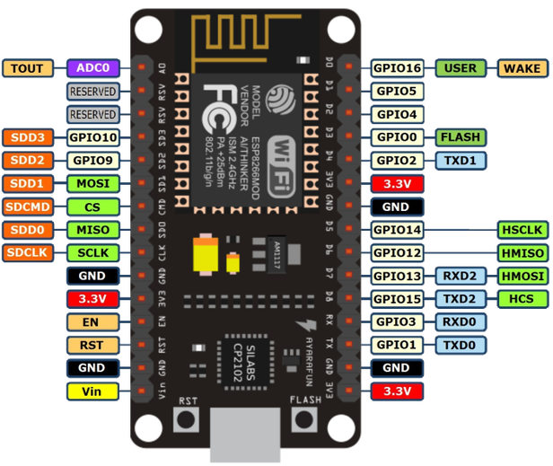
Node MCU
Open-source, Interactive, Programmable, Low cost, Simple, Smart, WI-FI enabled
NodeMCU is an open source IoT platform. It includes firmware which runs on the ESP8266 Wi-Fi SoC from Espressif Systems, and hardware which is based on the ESP-12 module.
Node MCU is the wifi module that we use to connect the hardware to the Internet.Because of its similarity with Arduino Boards, it can be programmed by the Arduino IDE.

Slide 7
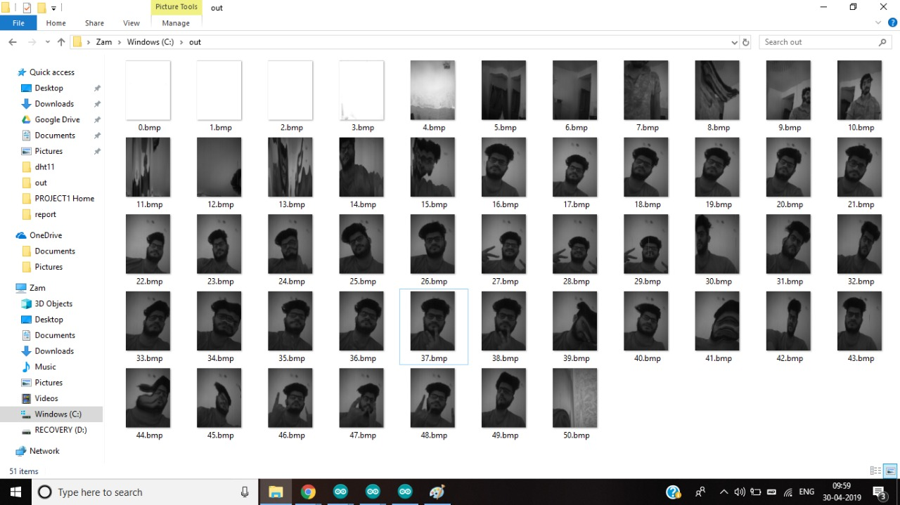
CAMERA MODULE
Camera Module works on variable registers of the Camera Module OV7670 .It takes a snapshot through the len and saves each pixel in 2 bytes, one being the Grayscale data and other being the Coloured data.
Then a Java program using the help of jdk 1.8.0_74 outputs the the image formed in the in the Arduino registers intro .bmp format.

Slide 8
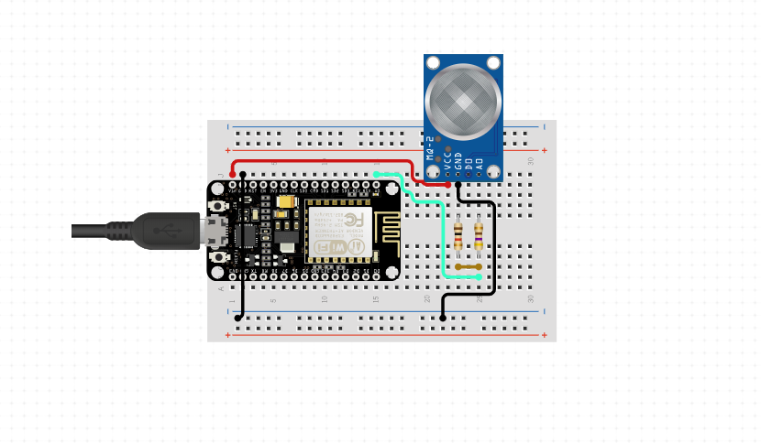
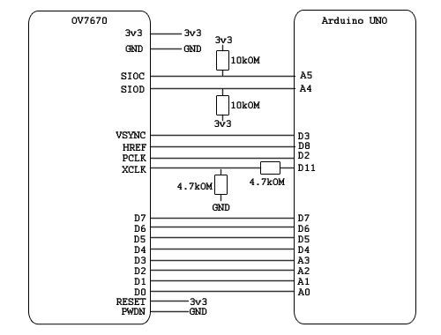
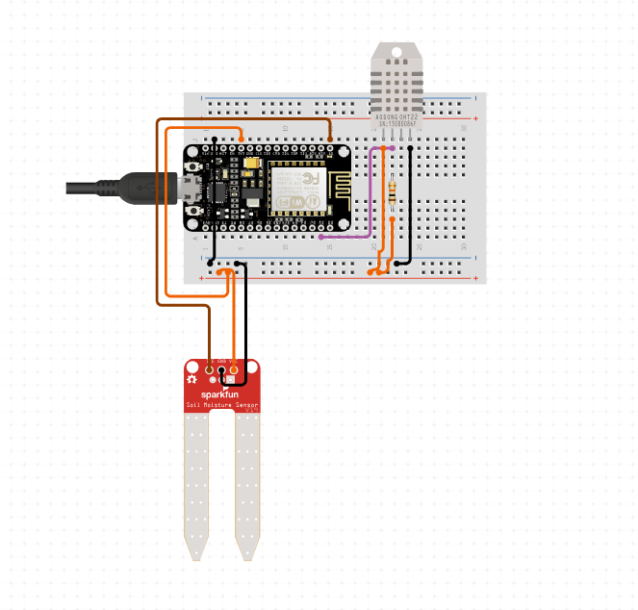
Circuit Diagram

Slide 9
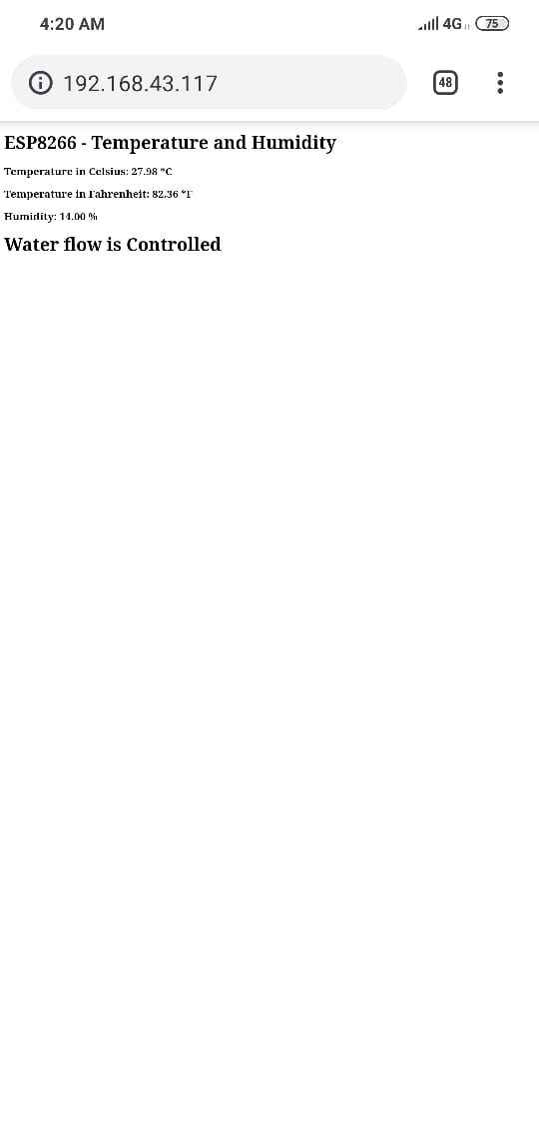
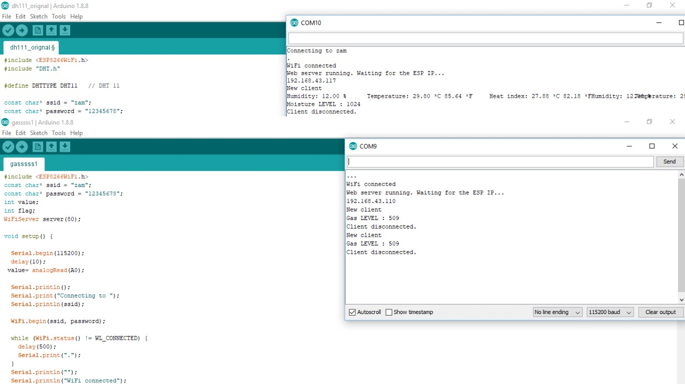
SNAPSHOTS
*These are Snapshots from Temperature & Water Control Module.

Slide 10
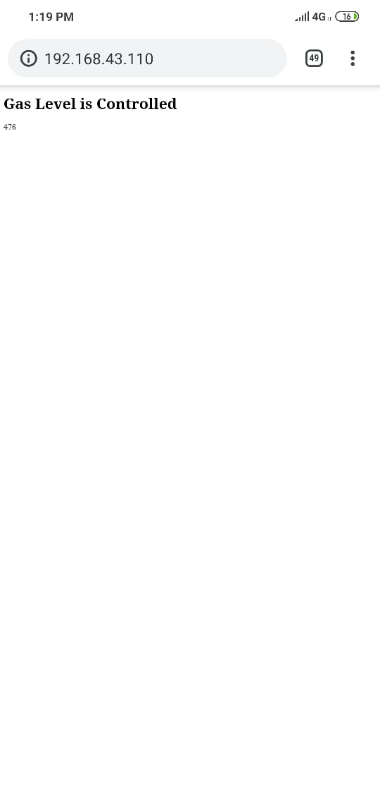
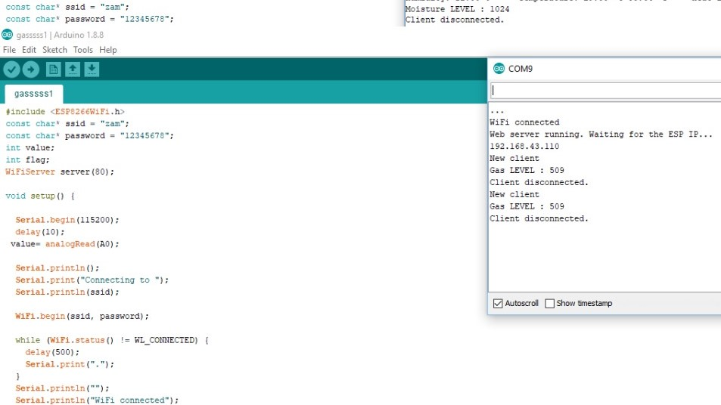
SNAPSHOTS
*These are Snapshots from Gas control Module.

Slide 11

SNAPSHOTS
*These are Snapshots for Camera Module.

Slide 12
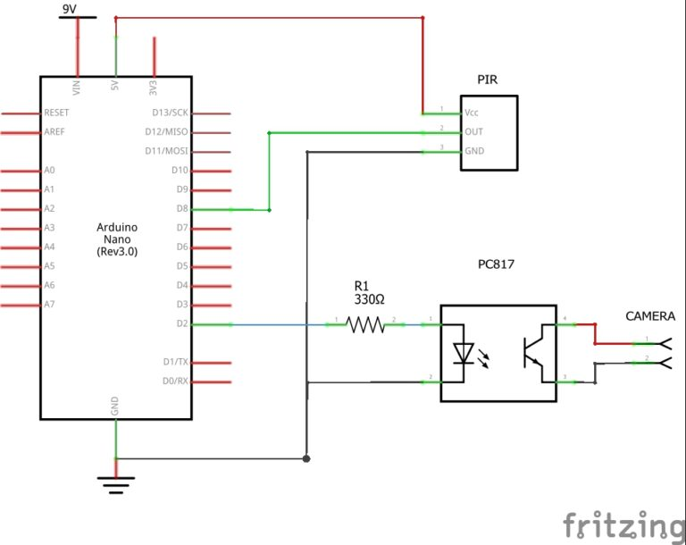
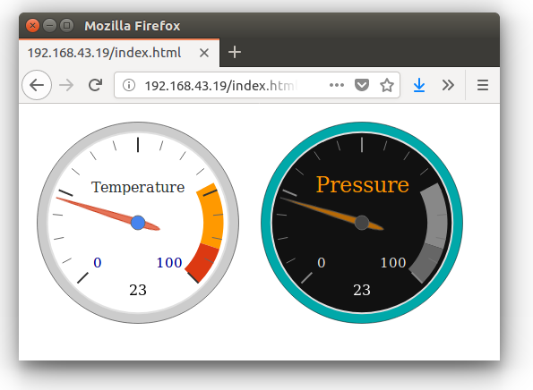
Proposed Updates
The total modules that we made are still using simple web pages and we propose to add CSS, JavaScript and using AJAX to make it a fully functional web app.
We also need to perfect our circuits and refine the circuit readings . Also we are in the process of designing the Security system which includes a Motion sensor which when triggered will send a snapshot using the Camera Module (OV7670) and send that data to the proposed Web App

Slide 13

Thank you!

